Slide 1

NETWORK PROGRAMMING
Group 3 : Storage

Slide 2

Members
Phạm Anh Hiếu BI9-106 : Code
Nguyễn Hoàng Sơn BI10-155
Trịnh Quốc Hiếu BI10-060
Present , slide , report

Slide 3
Table of content
Introduction
Structure

Slide 4
1. Introduction
Project content
Online storage system :
+ Authentication
+ Load balancer
+ Storage*
+ Client
b. Purpose
Store and return file

Slide 5
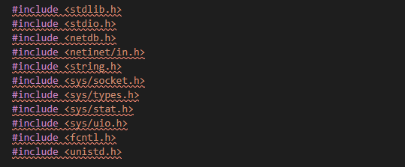
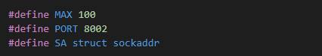
2. Structure
a. Library
Libary
Connect to PORT 8002

Slide 6
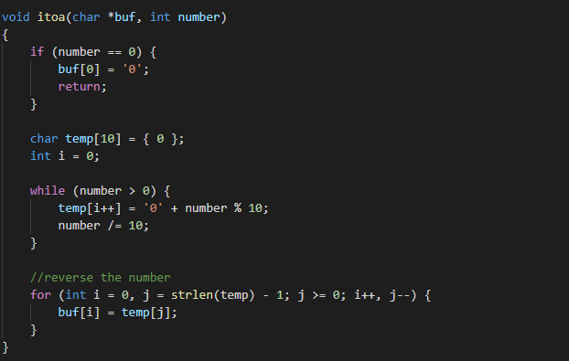
2.Structure
Change from integer to string

Slide 7
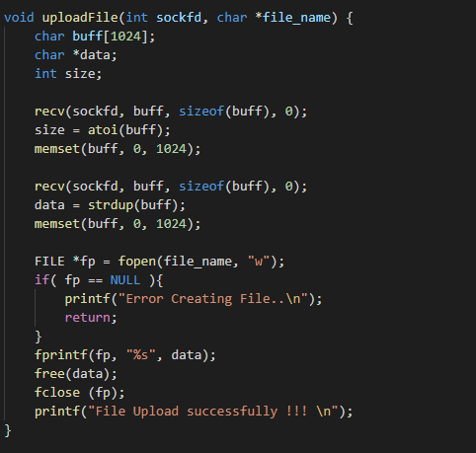
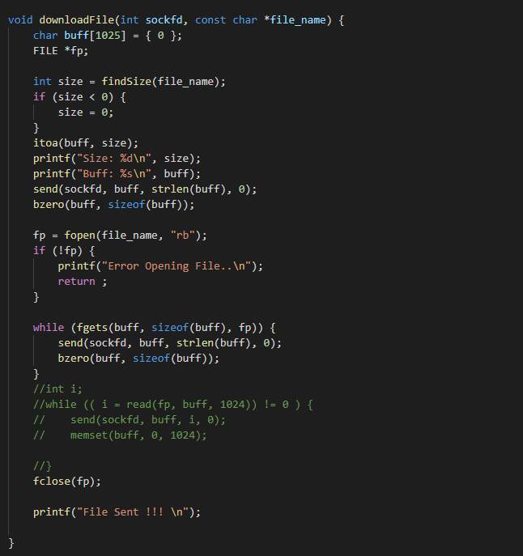
2.Structure
uploadFile
downloadFile

Slide 8
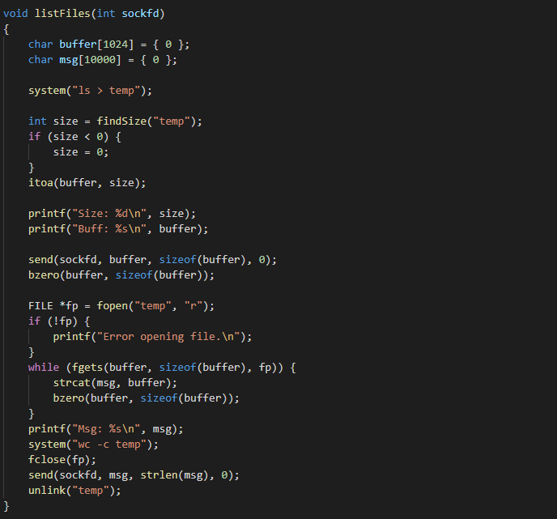
2.Structure
List the file in server

Slide 9
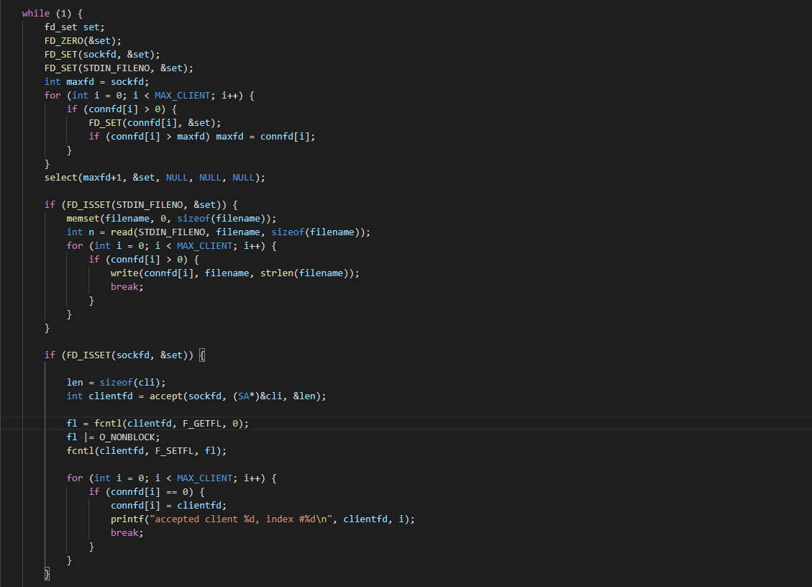
2.Structure
Connect to client

Slide 10
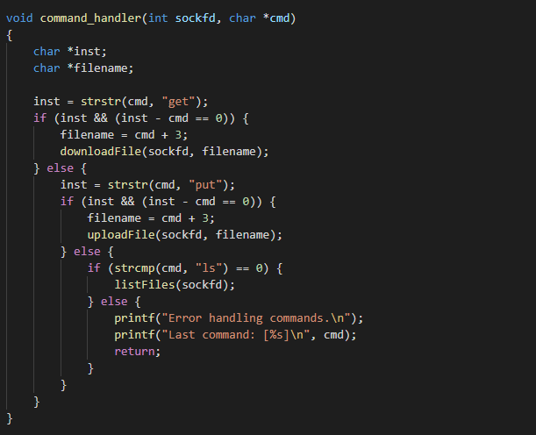
2.Structure

Slide 11
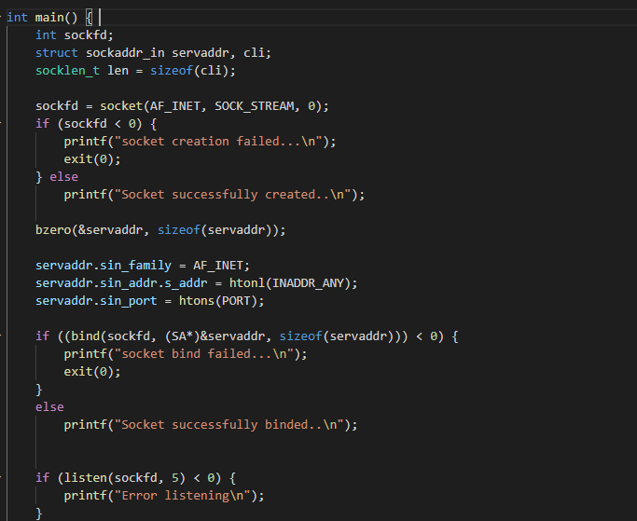
2.Structure
Create a socket

Slide 12
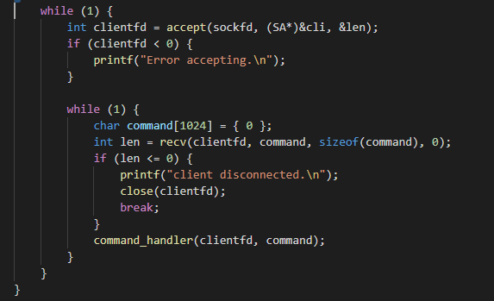
2.Structure
Connect to new client
Interactive to new client

Slide 13


